Slide 1


Bryant Esports
Team 1: Alexander Bean, Amanda Cesario, Zachary Cullison, Janaye Ferrante, Alyssa Gee

Slide 2

Describe the business. How does it work? What were the challenges?
The business is an Esports organization.
An e-sports organization is a large-scale business that operates in video game competition.
We recruit talent to represent our organization.
We consider character, skill, and passion.
Two different sides: Competitive and Casual
Competitive teams compete for championship titles for our organization
Content creators stream and post videos of content (video games or not) and keep an inflow of loyal followers and new ones
Challenges included: populating data and seeing the relationships.
Notes:
Zach

Slide 3

Why We Chose to do an e-Sports Organization
As a five-person group, we chose to use a more complex model for our organization.
Since most of us are familiar with e-sports, we have a good understanding of the model.
Four of us are active members of the Bryant eSports club.
Of that four, three are members of the club's E-Board.
Notes:
Zach

Slide 4

Workbench Design

Slide 5
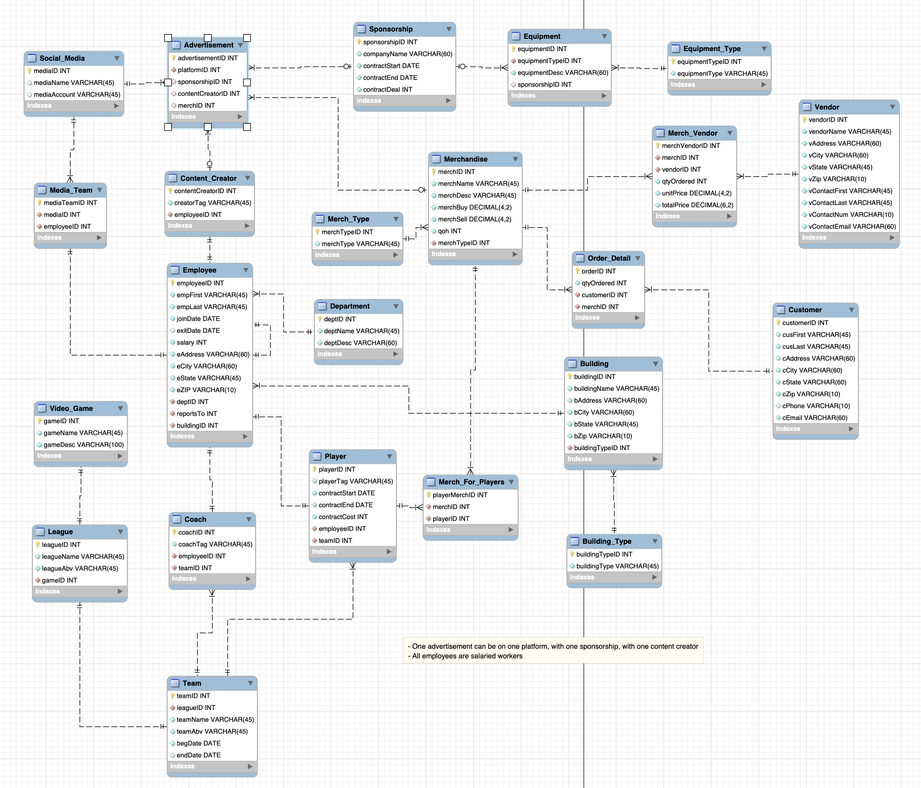
Notes:
Amanda
This is our workbench design, we’re going to break it down into different sections so that it’s easier to digest since it is a quite complex design.
Our design consisted of the people who are part of this organization, different departments and teams, equipment we need to operate and more

Slide 6
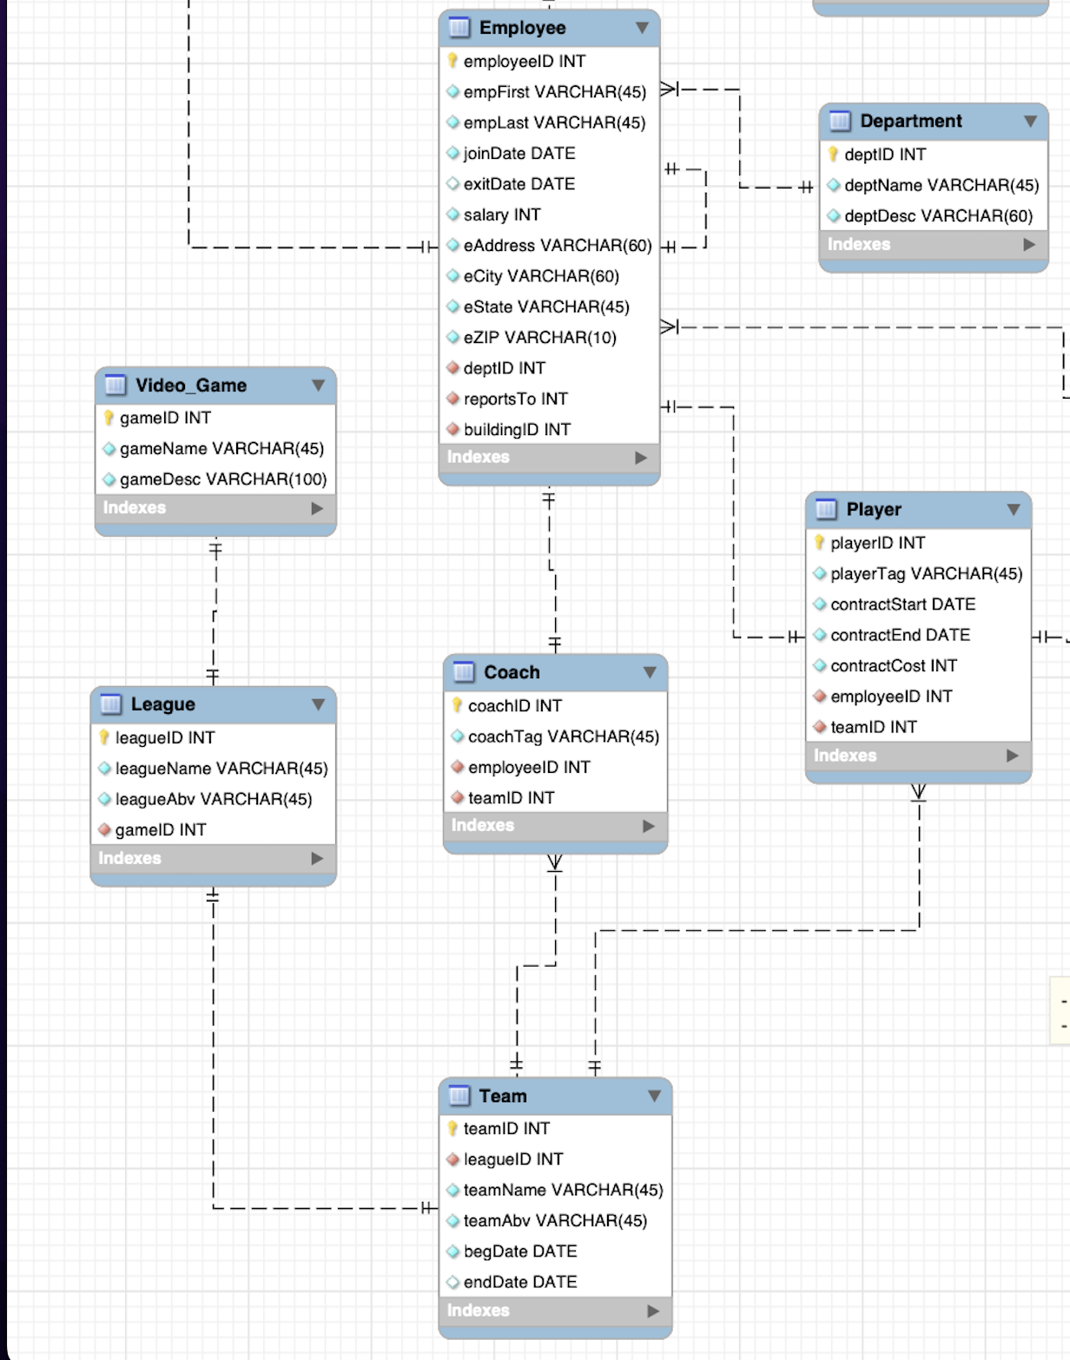
In-Depth Workbench
Covers employees and the e-sports segment of our business
Assignments departments to employees
Defines select employees into players and coaches
Connects players/coaches into teams
Video games and professional leagues are connected to teams
Notes:
Amanda
I’ll talk about the competitive and what we needed for that when creating our design
First table that is the base is our employee table, has a primary key, important info we need about an employee
Coaches can be an employees but they can only coach one team
We have players who are employees but they can’t be a coach, and players cannot play for multiple different teams. Once they’re on a team, they are locked on that roster
Then we have a lookup table of the different games we compete in, which ties into the league we will be competiting in, and the team that competes in that league and all have a 1-to-1

Slide 7
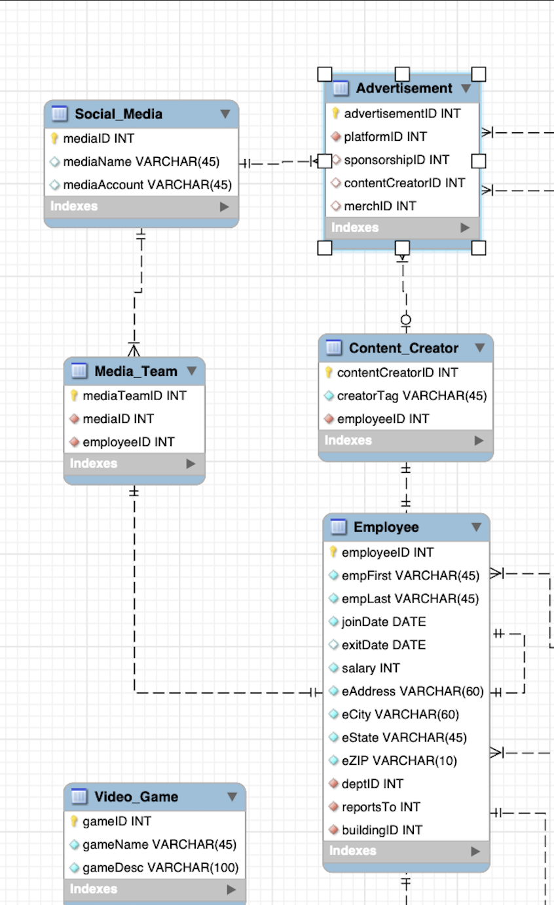
In-Depth Design
Covers employees and the social media side of our business
Assigns specific contracted employees to content creator
Also assigns marketing department to media team
Connects tables to joint "advertisement" table, which hold data of brand deals and sponsorships
Notes:
Alyssa

Slide 8
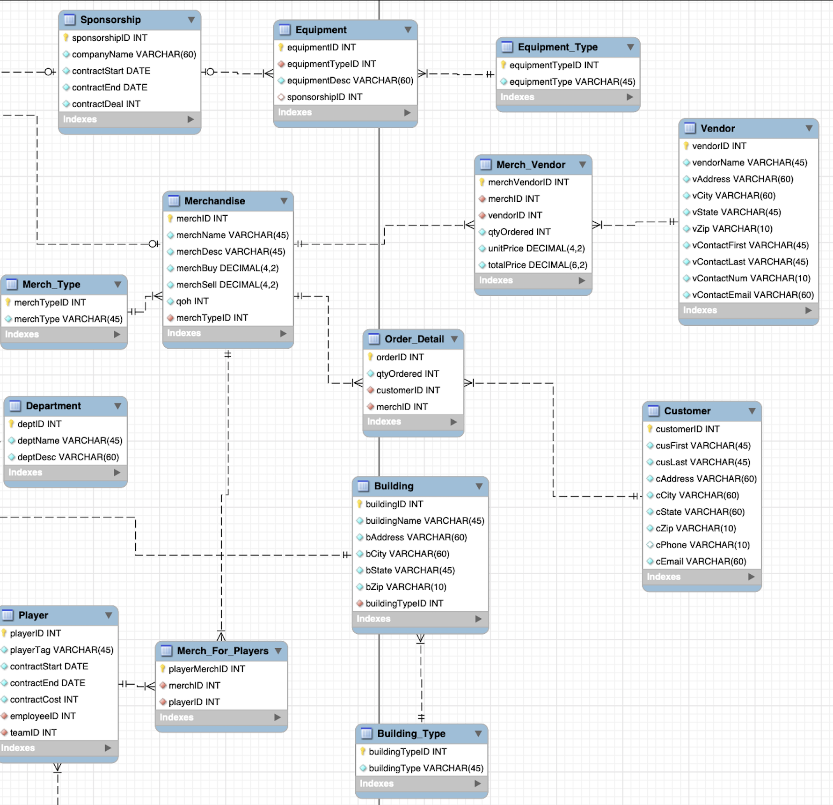
In-Depth Design
Business-oriented side of design
Lots of look-up tables
Made up of merchandise, equipment, and records for vendors and customers
Transactions were not covered in our design, but database includes order details for implementation
Notes:
Janaye

Slide 9

Business Rules
One advertisement can be on one platform, with one sponsorship, and with one content creator.
All employees are salaried workers.
An employee can be either a player, content creator, or coach.
An employee cannot be both a player and a coach
Content creators cannot be a coach or a player
One team per professional league and video game
Notes:
Zach

Slide 10
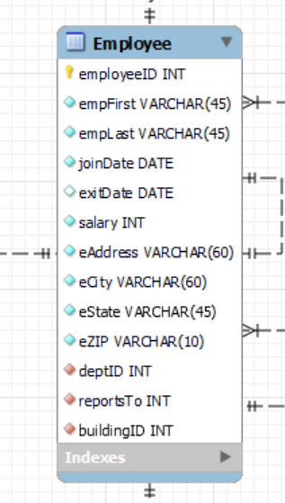
What data types did we use, and for what purpose?
For PK, INT is auto incremented, and we utilized that feature throughout our database
VARCHAR for a string with up to blank characters.
Used in descriptions of departments, merch, etc.
DATE since our database contains lots of dates for employment and contracts
Format was YYYY-MM-DD
DECIMAL for salaries, contracts, sponsorship deals, merch prices, and vendor prices
Notes:
Zach

Slide 11
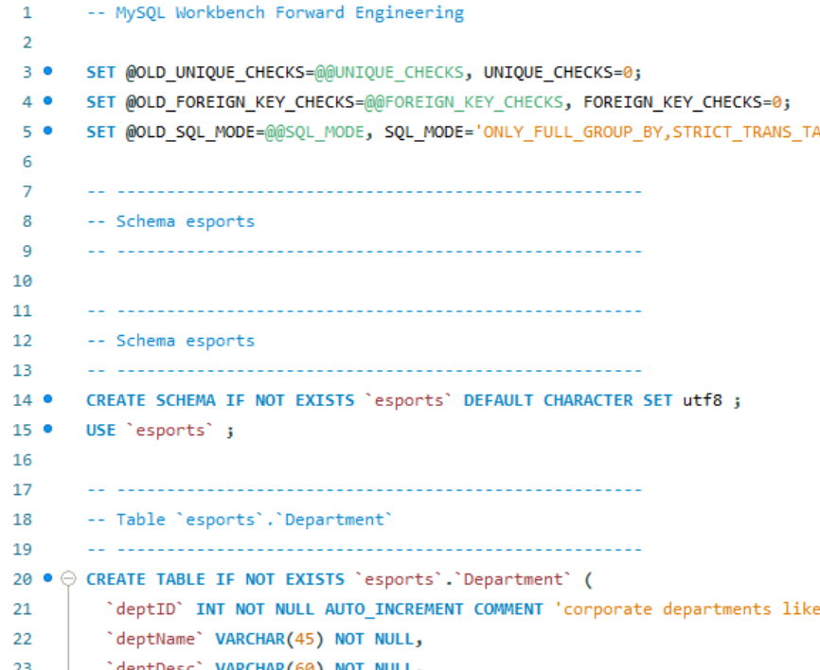
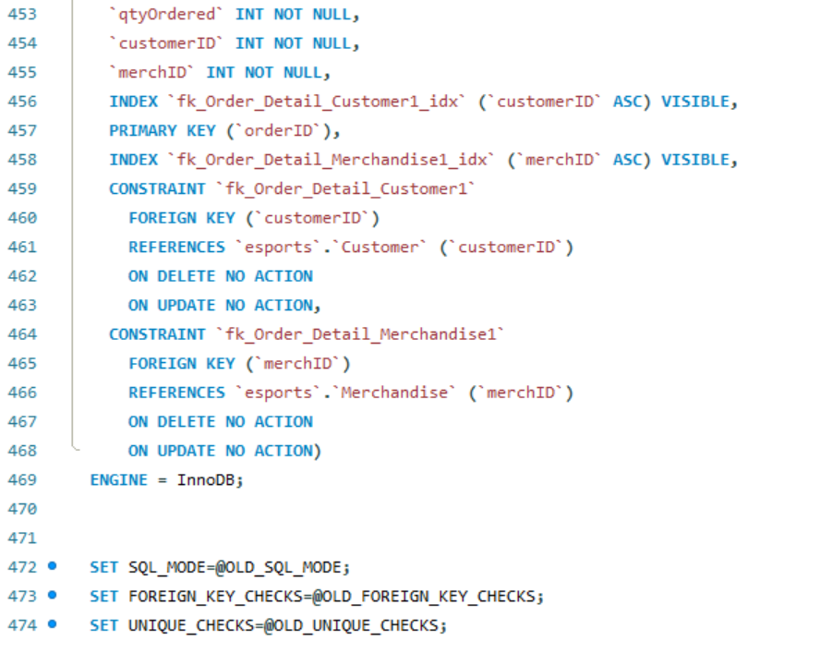
Create Code
Notes:
Alyssa

Slide 12
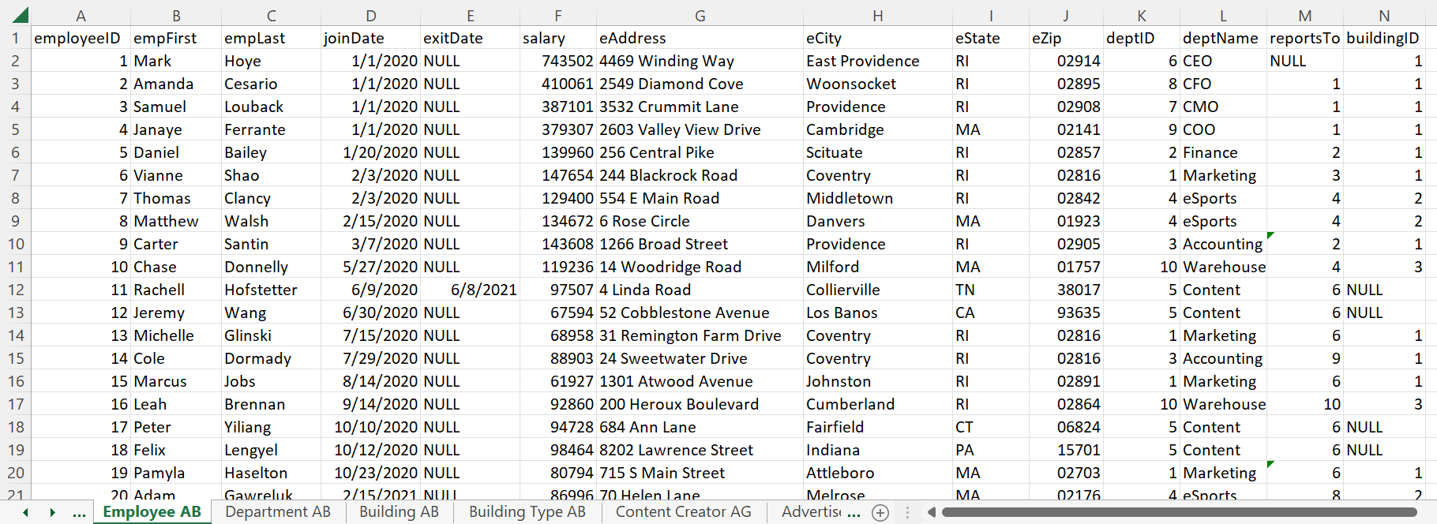
Planning our Data
Made a collaborative Excel sheet to plan out data before insertion
Used auto-increment feature for all IDs, manually wrote on Excel sheet to ensure referential integrity throughout the tables (VLOOKUP)
Notes:
Alex

Slide 13
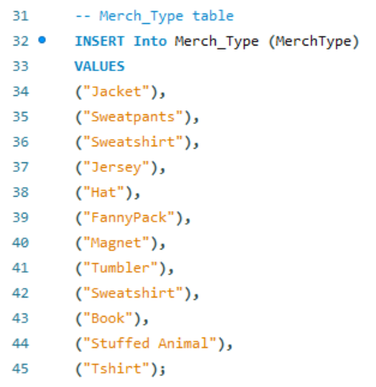
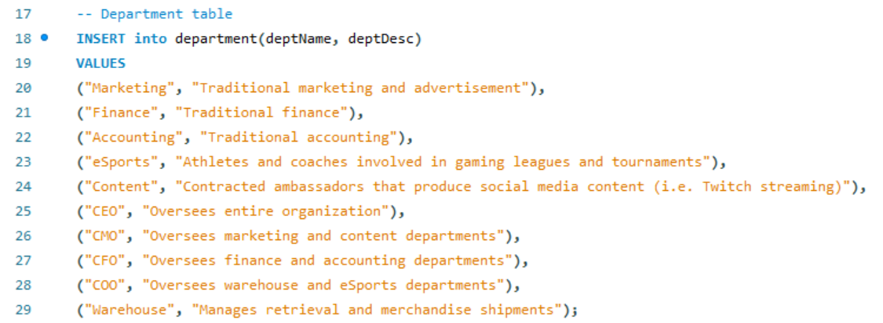
Insert Statements
Started by creating lookup tables
Did first because they are referenced as FKs in other tables
Notes:
Alex

Slide 14
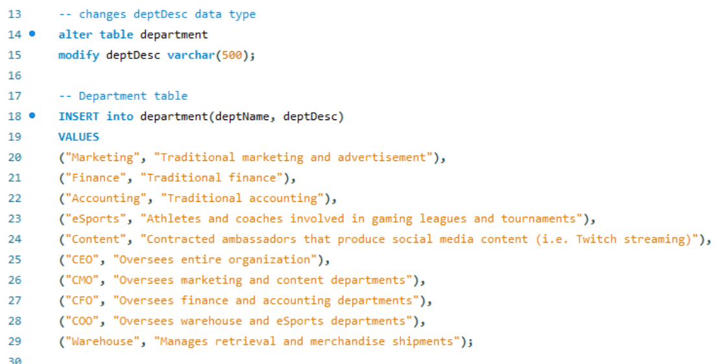
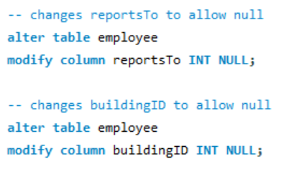
Insert Statements
Had to make changes to data types to fix issues during insertion
Notes:
Alex

Slide 15
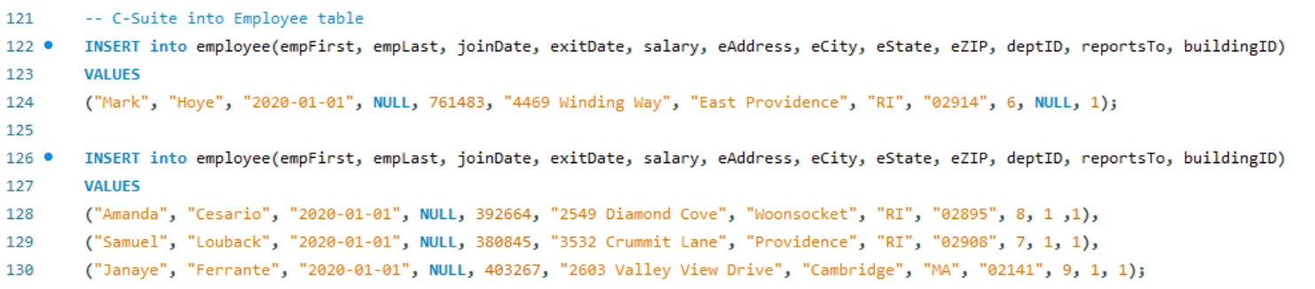
Insert Statements
Inserted CEO, then other c-suite, then managers, then employees
Ensured referential integrity of our "reportsTo" recursive relationship
Notes:
Alex

Slide 16
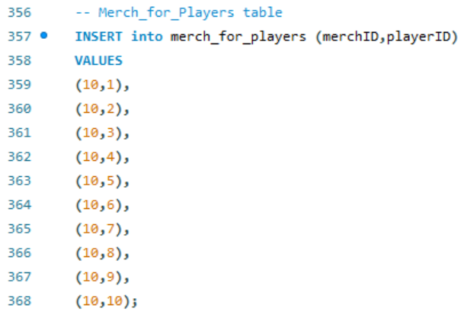
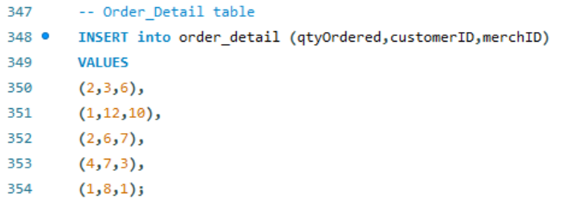
Insert Statements
Populated tables with only foreign keys at the end
Notes:
Alex

Slide 17

Any Questions? Next onto One Table Queries
Notes:
Janaye

Slide 18
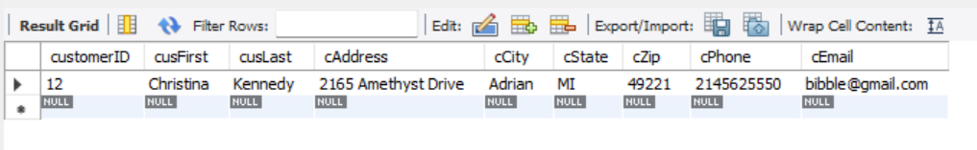
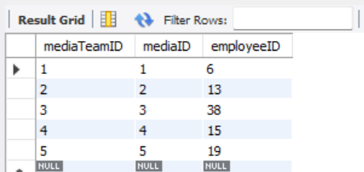
Basic one-table queries (examples 1 and 2)
Select *
from customer
where cusFirst like 'C%'
Select * from media_team
Notes:
Janaye

Slide 19
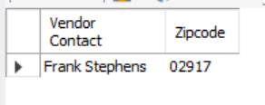
Basic one-table queries (example 3)
Select concat (vcontactFirst, ' ', vcontactLast) 'Vendor Contact',
vzip 'Zipcode'
from vendor
where vzip = 02917
Notes:
Janaye

Slide 20

Multi-Table Queries

Slide 21
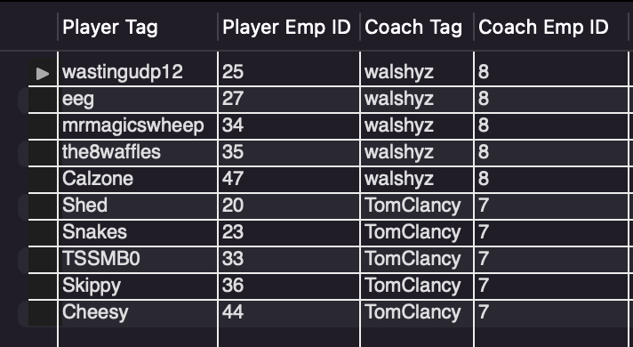
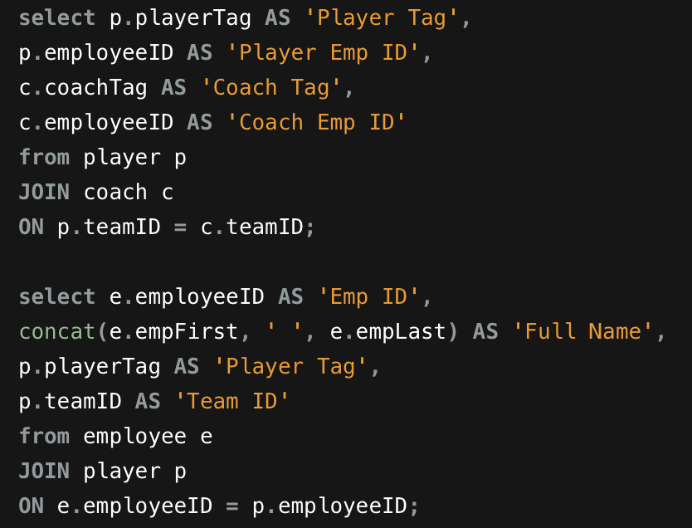
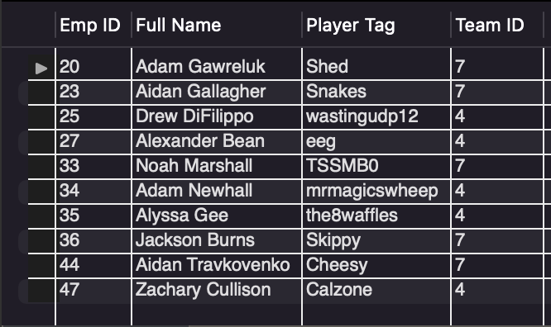
Joins
Notes:
Amanda

Slide 22
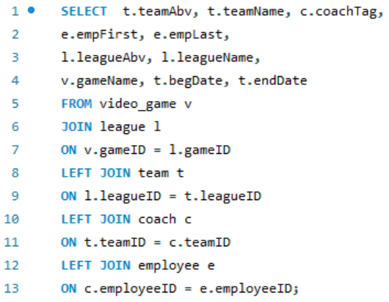
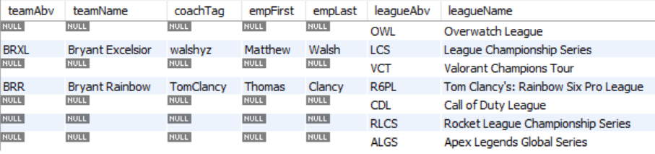
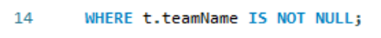
More Joins
Notes:
Amanda

Slide 23
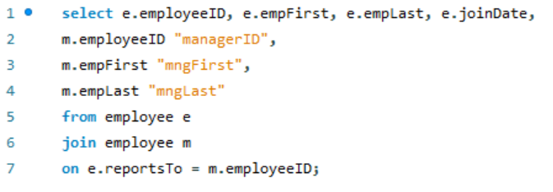
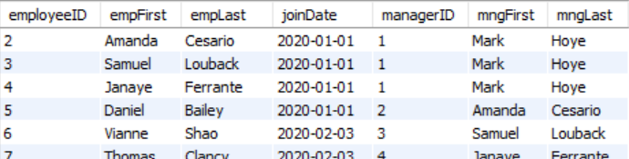
Recursive Relationship
Table joins on itself to display relationships between employees
Notes:
Alex

Slide 24
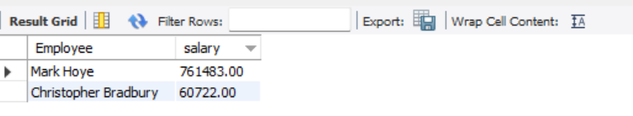
Min and Max
Start of Summary Queries
Select
CONCAT(empFirst,' ', empLast) Employee, salary
From employee
Where salary = (select Min(salary) Lowest from Employee) OR
salary = (select MAX(salary) Highest from Employee)
Notes:
Janaye

Slide 25
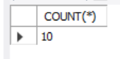
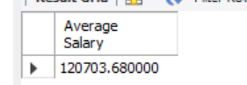
Count and Average
select count(*) from employee
Where eState = 'MA'
select avg(salary) 'Average Salary'
from employee
Notes:
Janaye

Slide 26

Subqueries
Notes:
Amanda

Slide 27
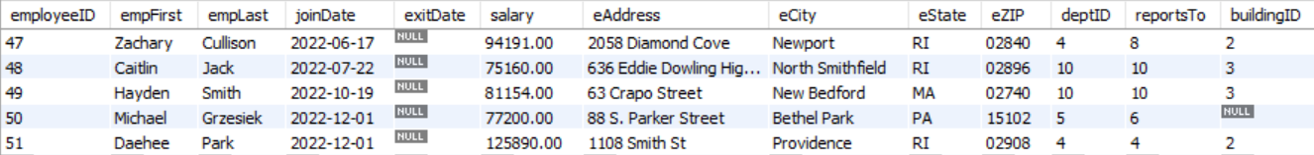
New Employee/Coach
INSERT into employee(empFirst, empLast, joinDate, exitDate, salary, eAddress, eCity, eState, eZIP, deptID, reportsTo, buildingID)
VALUES
("Daehee", "Park", "2022-12-01", NULL, 125890, "1108 Smith St", "Providence", "RI", "02908", 4, 4, 2);
Notes:
Amanda

Slide 28
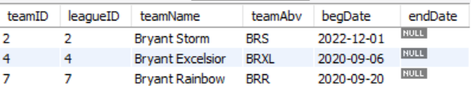
New Team: Overwatch
update team set teamName = 'Bryant Storm',
teamAbv = 'BRS',
begDate = '2022-12-01'
where leagueID = 2;
Notes:
Amanda

Slide 29
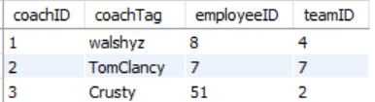
Adding into Coach table
INSERT INTO Coach(coachTag, employeeID, teamID) VALUES
("Crusty", 51, 2);
Notes:
Amanda

Slide 30

Views
Notes:
Alyssa

Slide 31
Finance Department
CREATE VIEW vw_financeDept AS
SELECT e.empFirst, e.empLast, e.salary, e.deptID, e.joinDate, e.eState, e.eZip,
d.deptName,
p.contractCost
FROM employee e
JOIN department d
ON e.deptID = d.deptID
LEFT JOIN player p
ON e.employeeID = p.employeeID;
SELECT empFirst 'Emp First', empLast 'Emp Last', eState 'State', eZip 'Zip', deptName 'Dept Name', salary 'Salary', contractCost 'Contract Cost'
FROM vw_financeDept
ORDER BY empLast;
SELECT empFirst 'Emp First', empLast 'Emp Last', eState 'State', eZip 'Zip', deptName 'Dept Name', salary 'Salary', contractCost 'Contract Cost'
FROM vw_financeDept
ORDER BY salary desc;
Notes:
Alyssa

Slide 32
CREATE VIEW vw_LoLCoach AS
SELECT e.employeeID, e.empFirst, e.empLast,
p.playerTag, p.contractStart, p.contractEnd,
t.teamID, t.teamName, t.teamAbv, t.begDate, t.endDate,
v.gameID, v.gameName, v.gameDesc,
l.leagueID, l.leagueName, l.leagueAbv
FROM employee e
RIGHT JOIN player p
ON e.employeeID = p.employeeID
LEFT JOIN team t
ON p.teamID = t.teamID
RIGHT JOIN league l
ON t.leagueID = l.leagueID
JOIN video_game v
ON l.gameID = v.gameID
WHERE v.gameID = 2;

Slide 33
Walshyz can only see LoL team information
SELECT employeeID 'Emp ID', empFirst 'Emp First', empLast 'Emp Last',
playerTag AS 'Player IGN', contractStart 'Contract Start Date', contractEnd 'Contract End Date',
teamName 'Team Name', teamAbv 'Team Abv', begDate 'Team Beg Date', endDate 'Team End Date',
gameName 'Game Name',
leagueName 'League Name', leagueAbv 'League Abv'
FROM vw_LoLCoach
ORDER BY empLast;

Slide 34
Walshyz cannot see R6 team information
SELECT employeeID 'Emp ID', empFirst 'Emp First', empLast 'Emp Last',
playerTag AS 'Player IGN', contractStart 'Contract Start Date', contractEnd 'Contract End Date',
teamName 'Team Name', teamAbv 'Team Abv', begDate 'Team Beg Date', endDate 'Team End Date',
gameName 'Game Name',
leagueName 'League Name', leagueAbv 'League Abv'
FROM vw_LoLCoach
WHERE gameID = 4
ORDER BY empLast;

Slide 35
Walshyz cannot see outside of LoL
SELECT employeeID 'Emp ID', empFirst 'Emp First', empLast 'Emp Last',
playerTag AS 'Player IGN', contractStart 'Contract Start Date', contractEnd 'Contract End Date',
teamName 'Team Name', teamAbv 'Team Abv', begDate 'Team Beg Date', endDate 'Team End Date',
gameName 'Game Name',
leagueName 'League Name', leagueAbv 'League Abv'
FROM vw_LoLCoach
WHERE empLast = ‘Gallagher’;

